Slide 1


NVMe Over Fabrics Senior Design Project May 25, 2016
ERIC LITVINSKY
JAYDEN NAVARRO
ALICE YU
TEAM MEMBERS:
JOHN GEMIGNANI
COY HUMPHREY

Slide 2
Problem Statement
Data Center
Compute Nodes (Servers)
Storage Array
NVMe over Fabrics Protocol
NVMe Drive
Internet
NVMe Drive
NVMe Drive
NVMe Drive
NVMe Drive
Goal: Benchmark and assess viability of nbdX (Pre-Spec NVMe over Fabrics)

Slide 3
Our Approach
Assemble protocol stack
Fix stability issues
Build benchmarking suite
Gather and analyze benchmarking results

Slide 4
Run_All Script
Benchmarking Suite
Python automated framework
Python scripts for benchmarking tools
‘Run_All’ Bash script with error report handling
Results parsed and outputted to CSV format
I/O Benchmark
Network Benchmark
Error Log
Custom Framework
Reports/Graphs
Git
Results
4

Slide 5
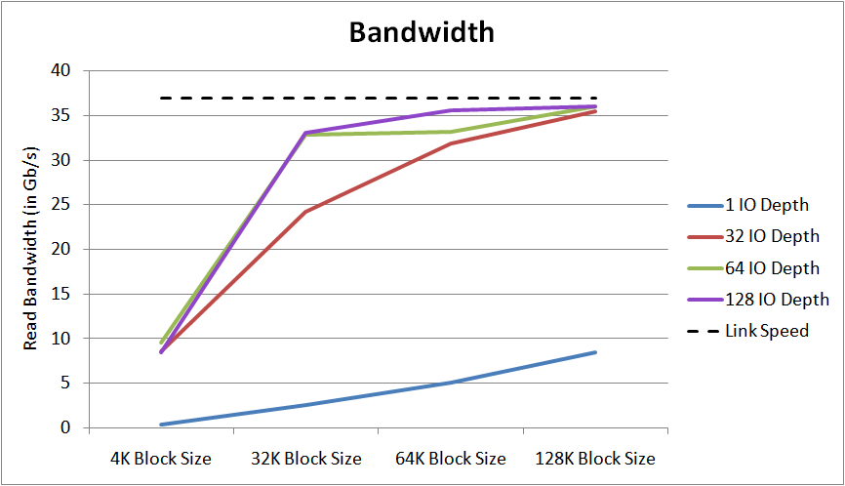
5

Slide 6
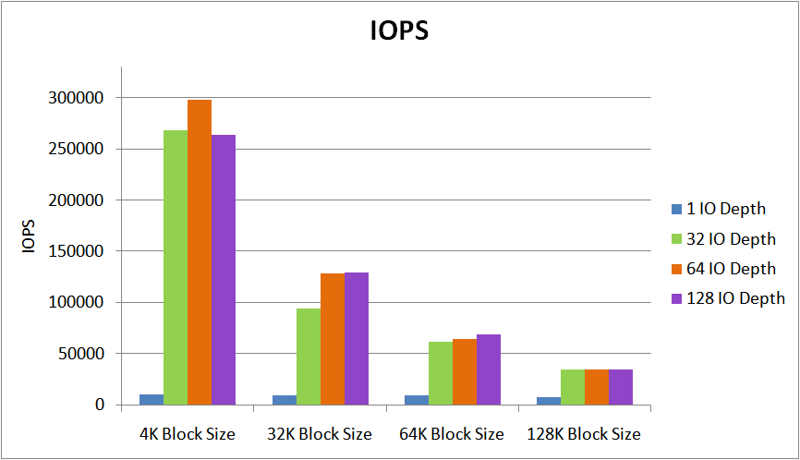
6

Slide 7
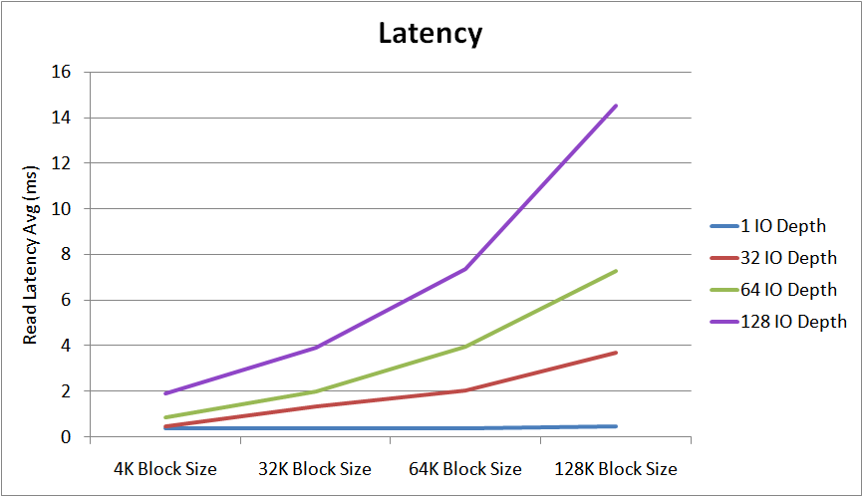
7

Slide 8
Summary
Analysis of nbdX
Bandwidth reached near maximum link speed
Latency within expected range of NVMe over Fabrics spec
IOPS exceed current NVMe attached drive capabilities
Local NVMe Attached Storage Compared to nbdX Remote Ramdisk
 | NVMe Locally Attached Drives | nbdX (NVMe over Fabrics) Ramdisk
Bandwidth | ~8.0 Gb/s | ~36 Gb/s
IOPS | ~100,000 4K IOPS | > 250,000 4K IOPS

Slide 9
Conclusion
NVMe over Fabrics is a viable solution for network attached storage arrays with NVMe drives

Slide 10
Thanks to
Samuel Fineberg, Ph.D., Distinguished Technologist, Storage Chief Technologist Office at Hewlett Packard Enterprise
Dr. Linda Werner, Ph.D., Faculty Advisor, UCSC
Daniel Fava, Graduate Teaching Assistant, UCSC
Kevin Cheng for participating in the first half of the project
Hewlett Packard Enterprise for the hardware and support provided

